Slide 1







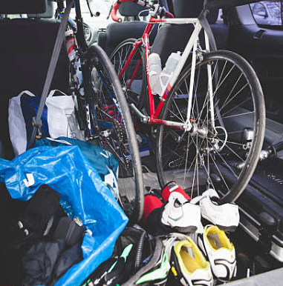
CRV
ACTIVE TRENDSETTER
URBAN
DIGITAL
PRACTICAL
COMFORT
MINIMAL
NATURE
ACTIVE
SPORTY
TACTILE
UNEXPECTED

Slide 2
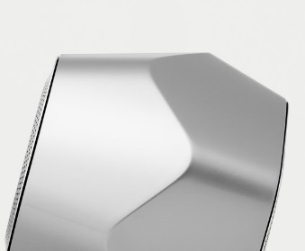
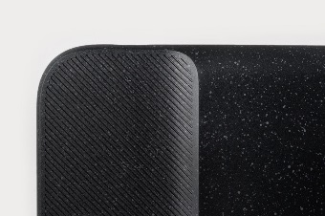
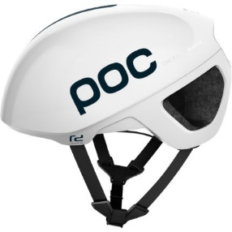
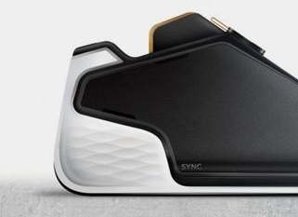

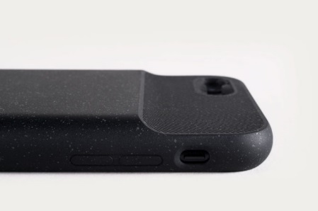
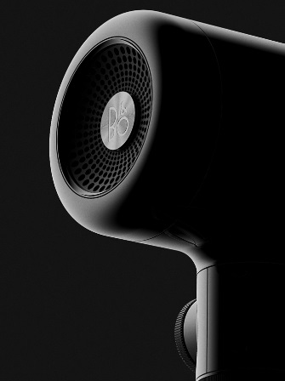

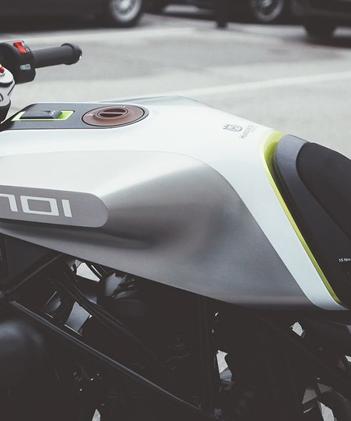
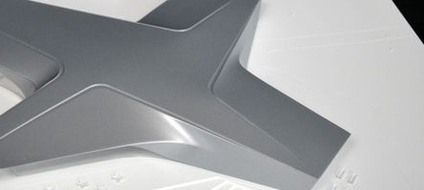
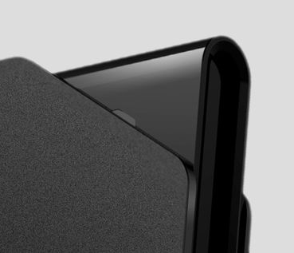
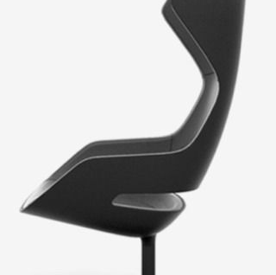
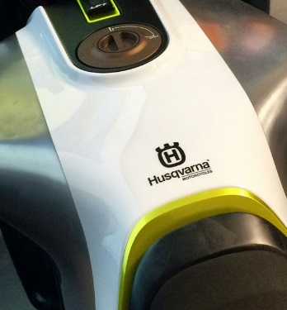
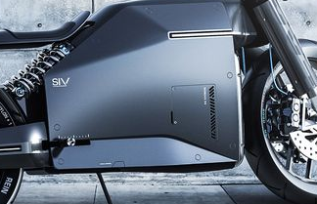
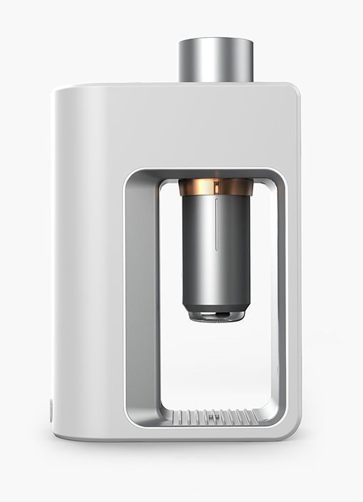
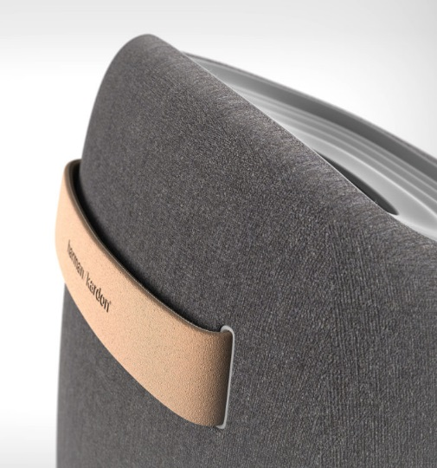
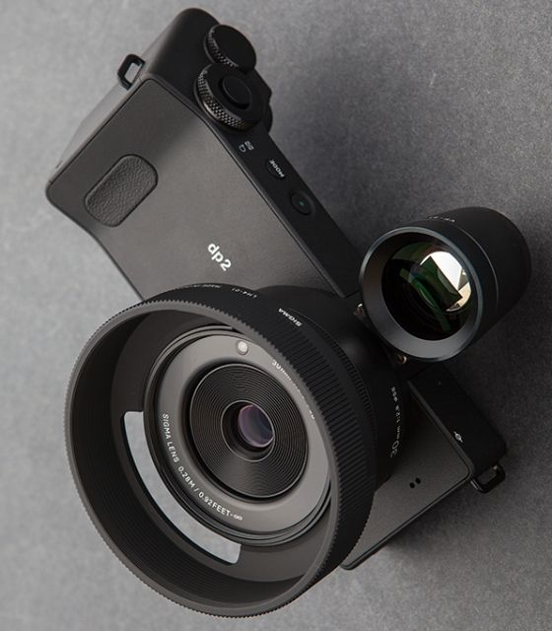
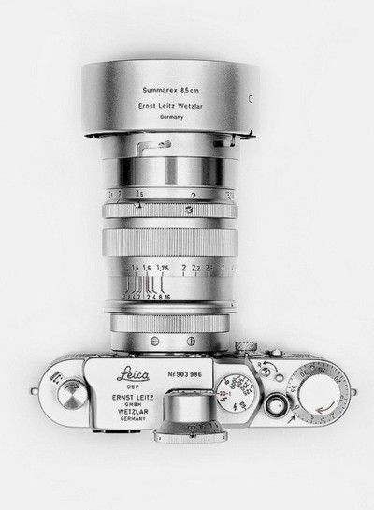
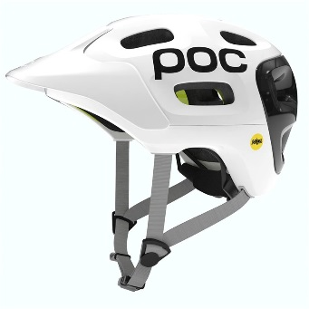
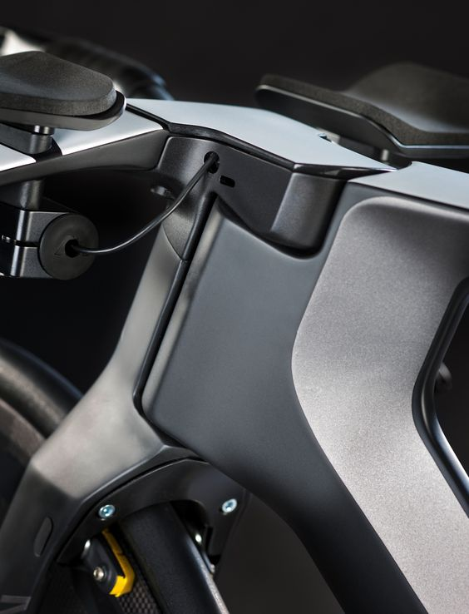
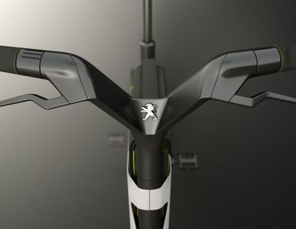
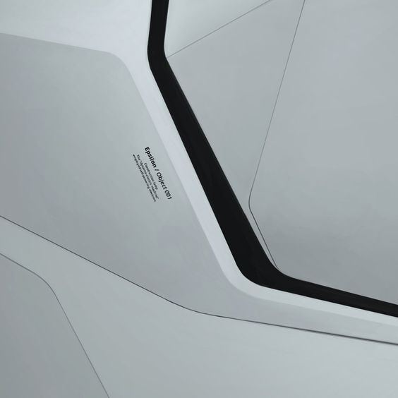
SOFT SHARPNESS
SIMPLE GEOMETRY
DRAMATIC CUTS
& BREAKUPS
DURABLE FUNCTIONALITY
TACTILE

Slide 3
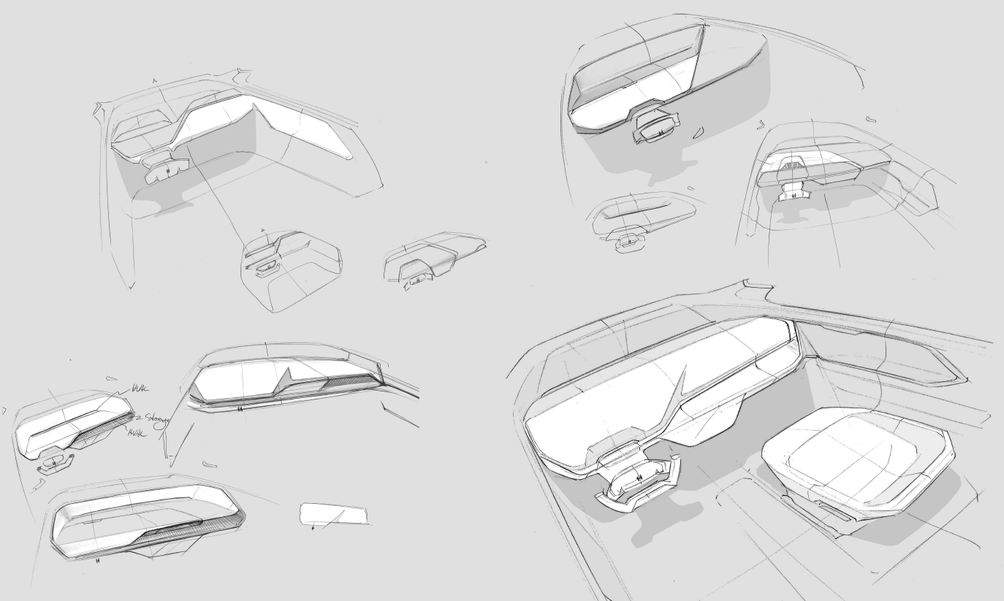
LOW IP – INTEGRATED FEATURES – DRAMATIC GESTURES – INTERACTION DEFINE ARCHITECTURE

Slide 4
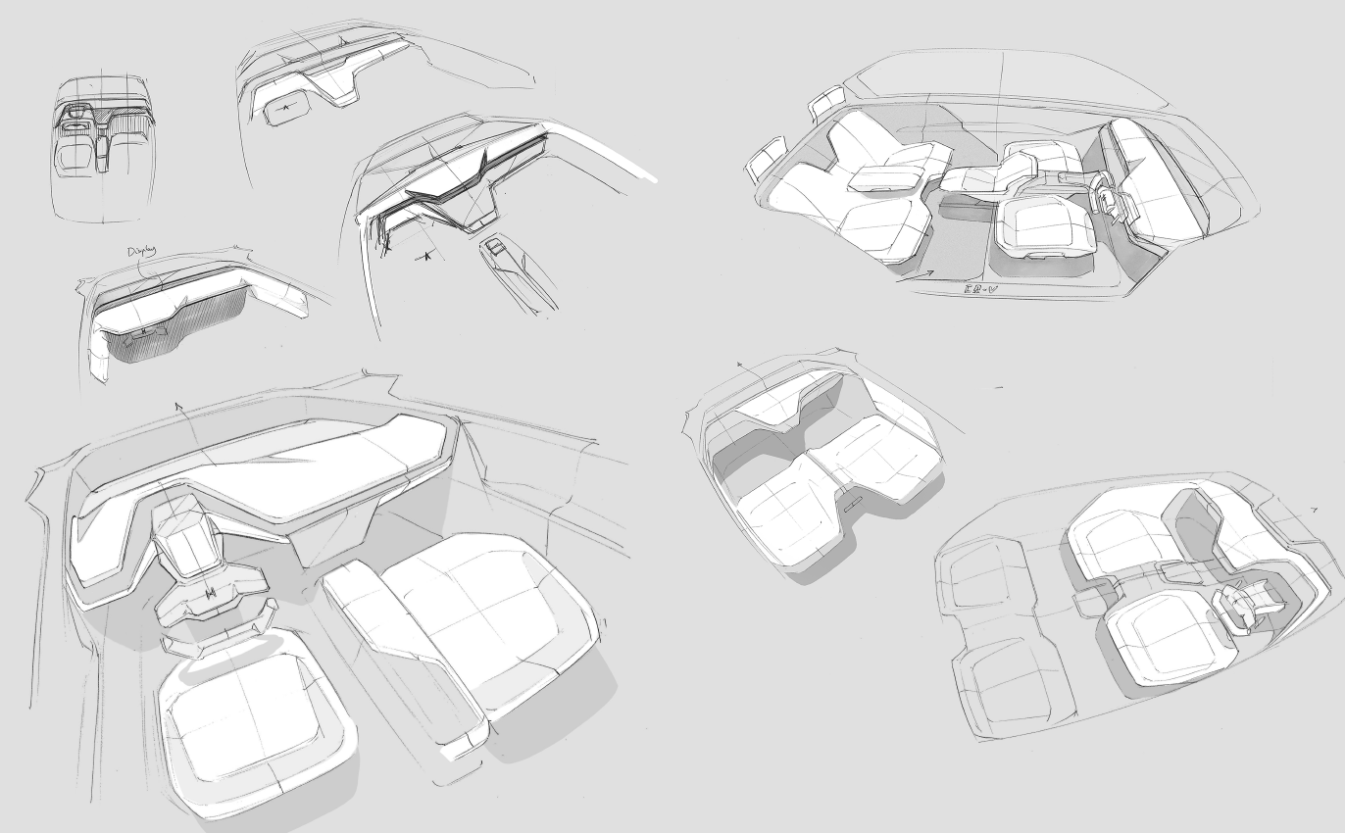

Slide 5
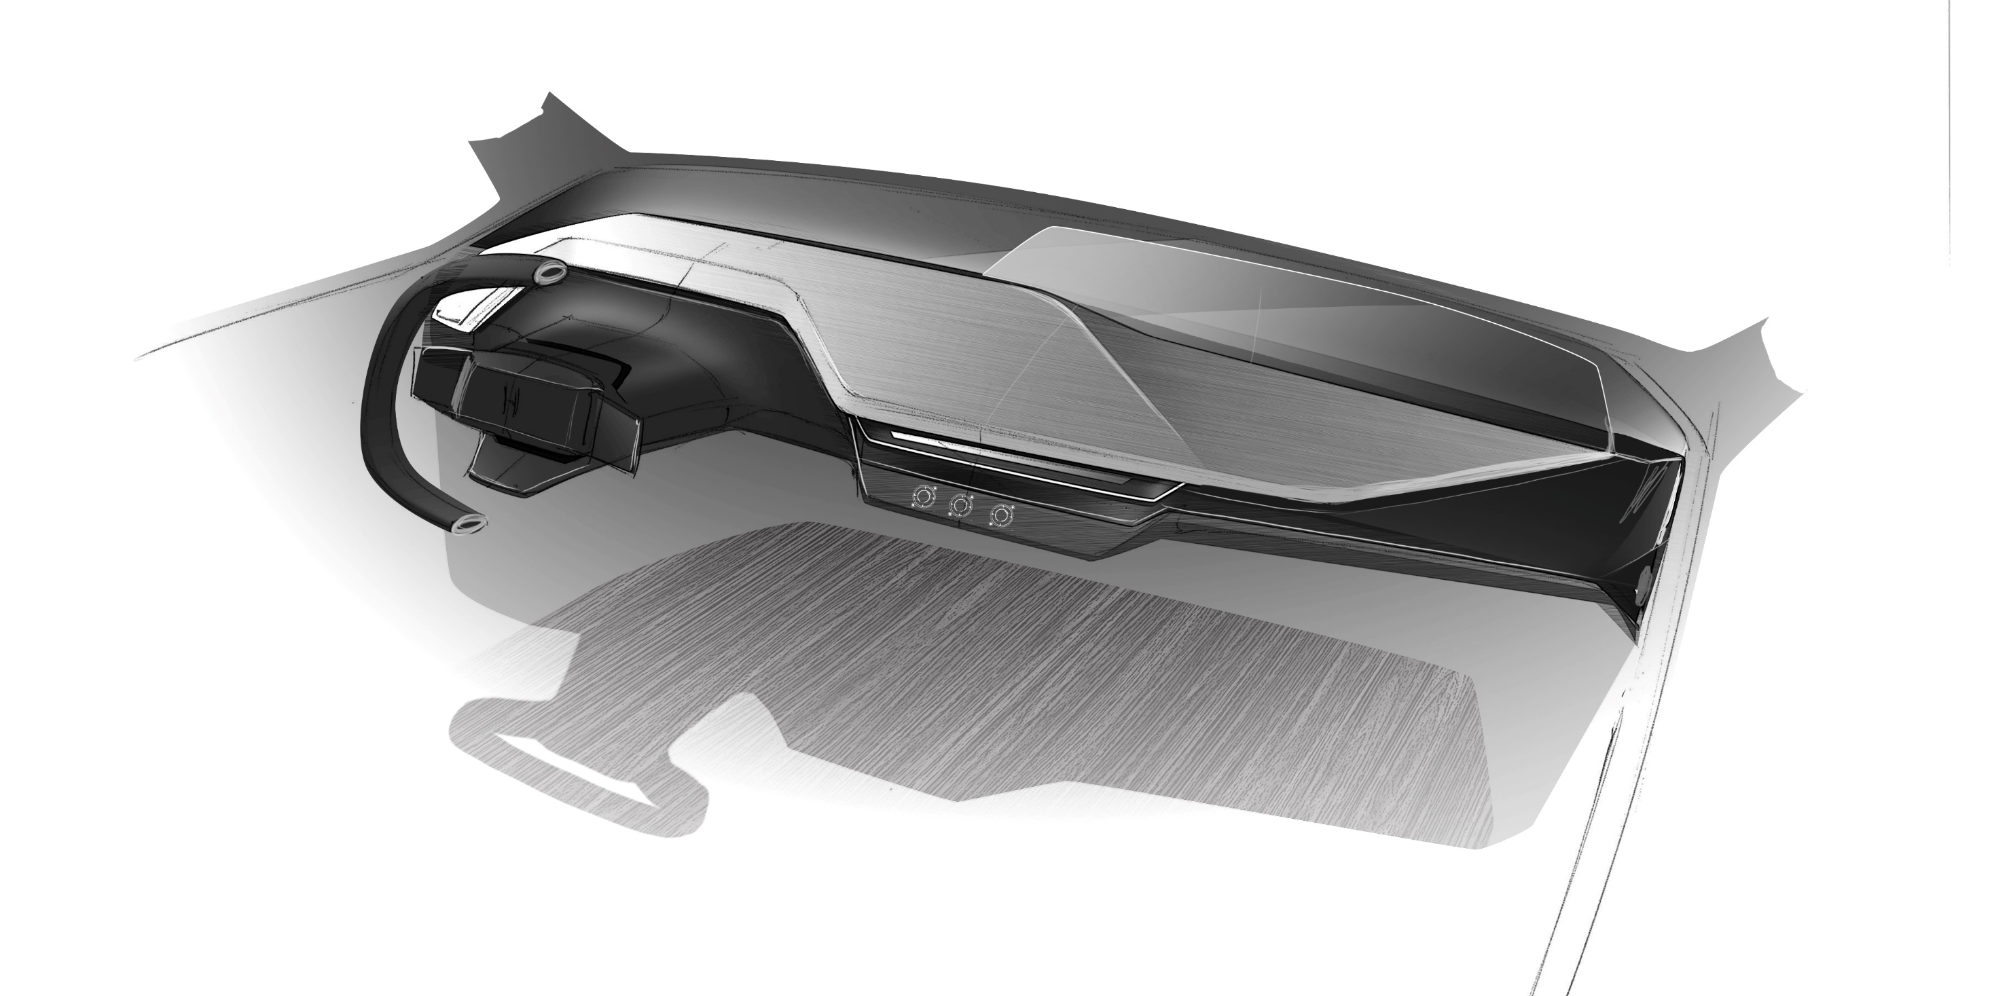
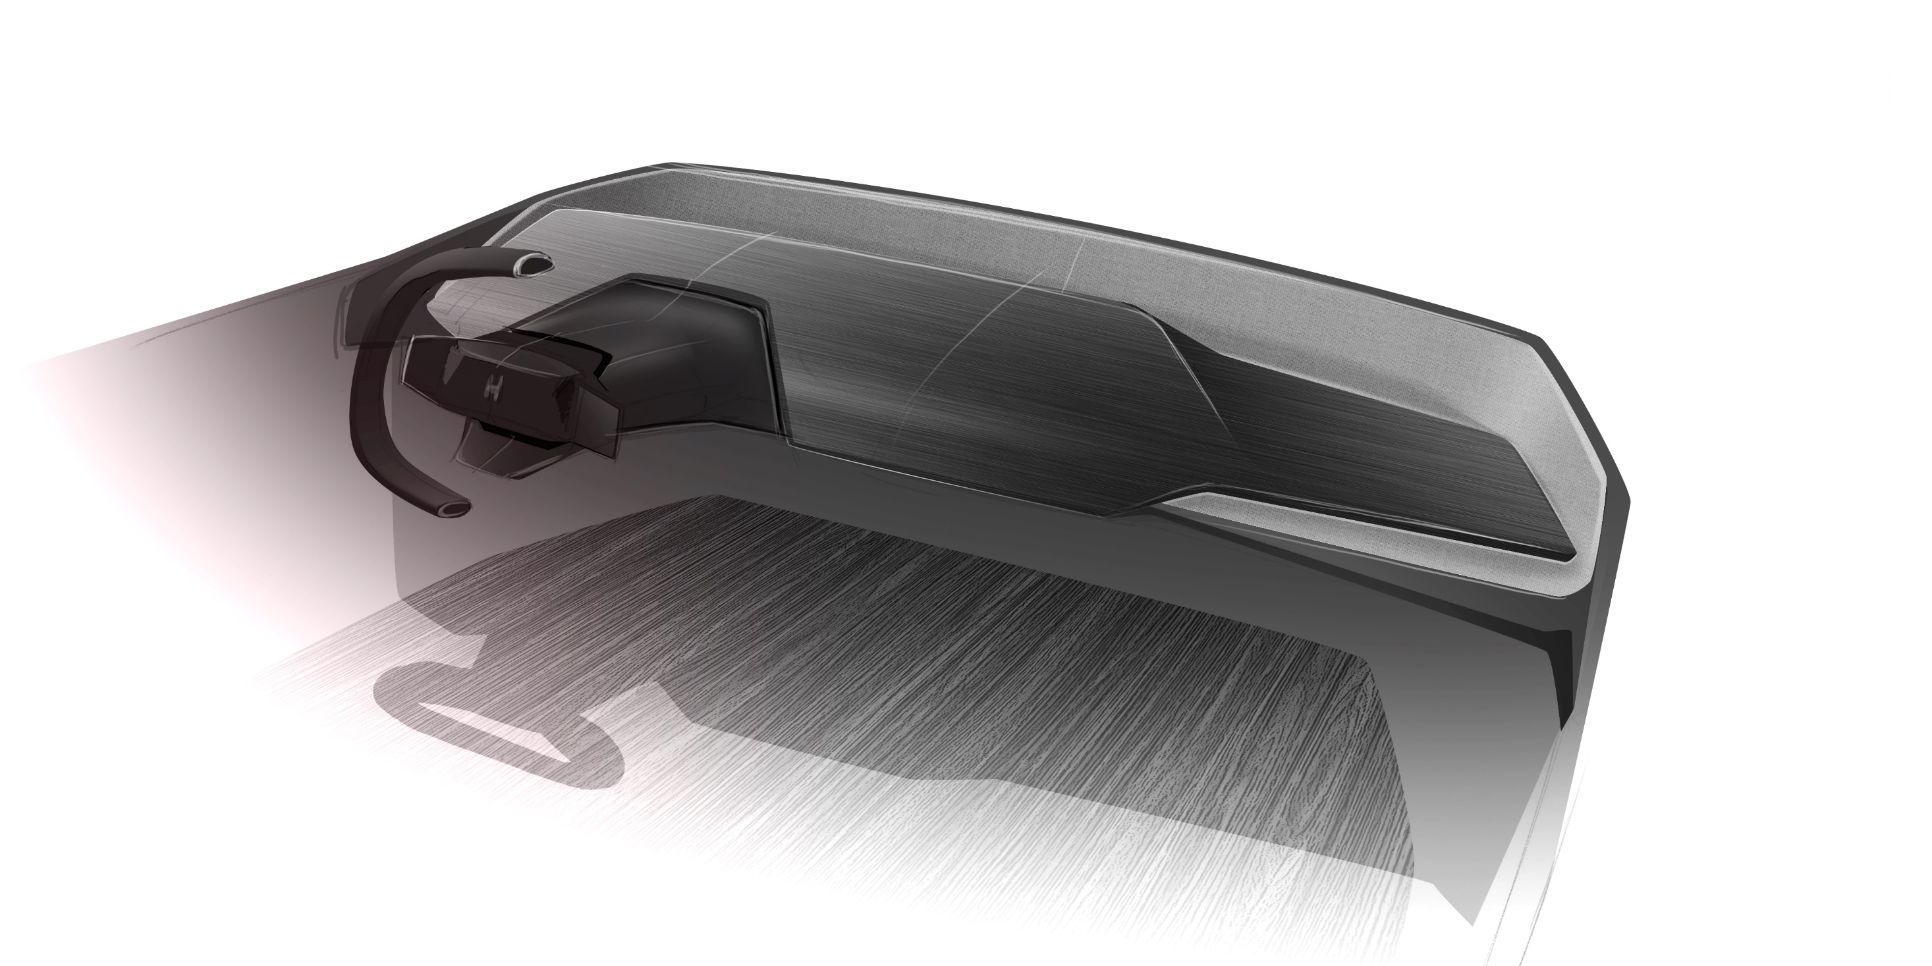
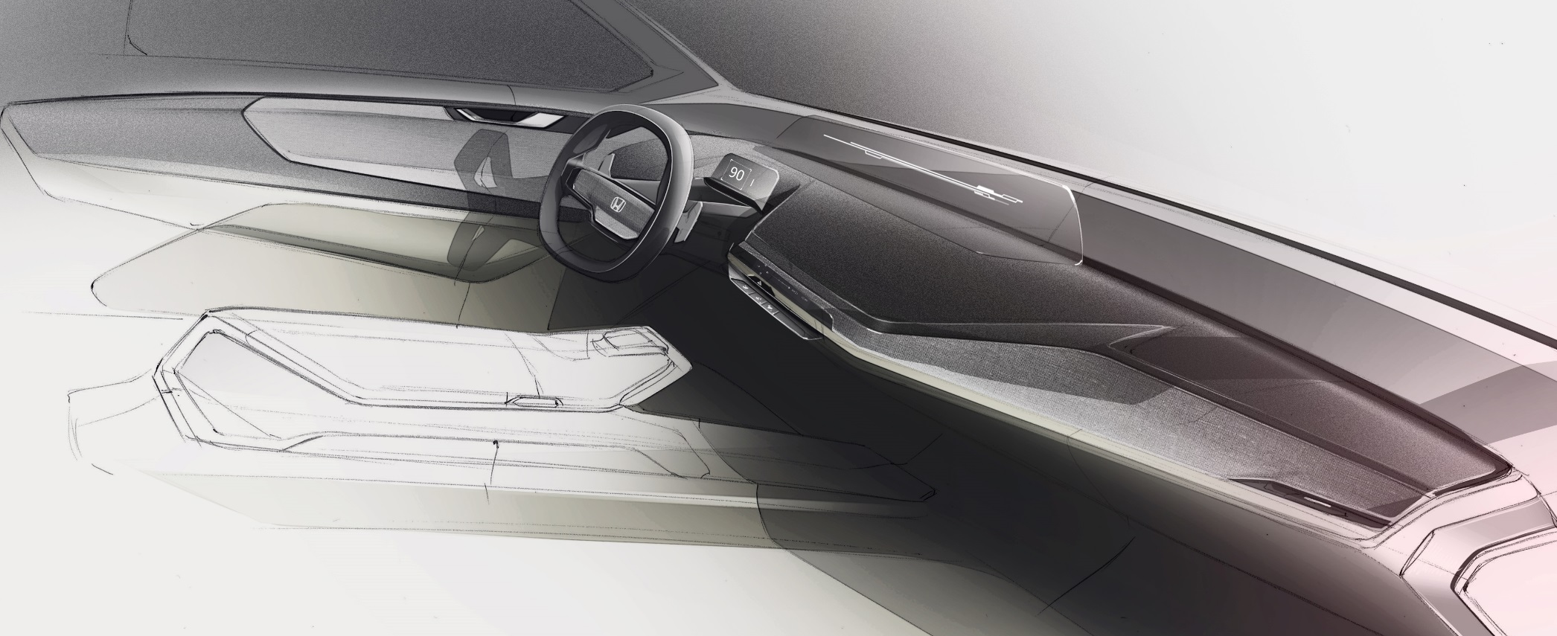

Slide 6
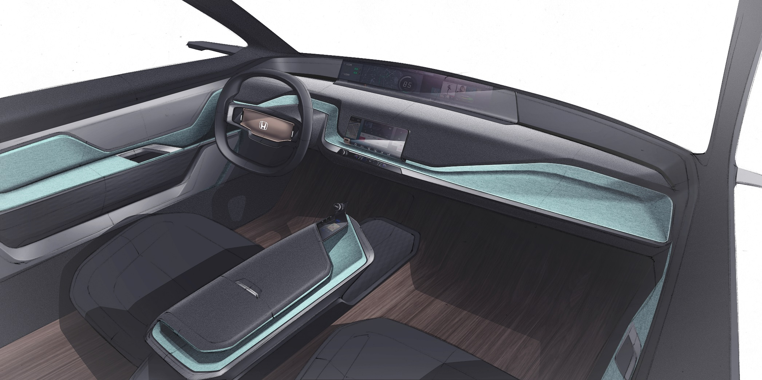
CUT THROUGH LAYERS OF HARD
& SOFT SURFACE

Slide 7
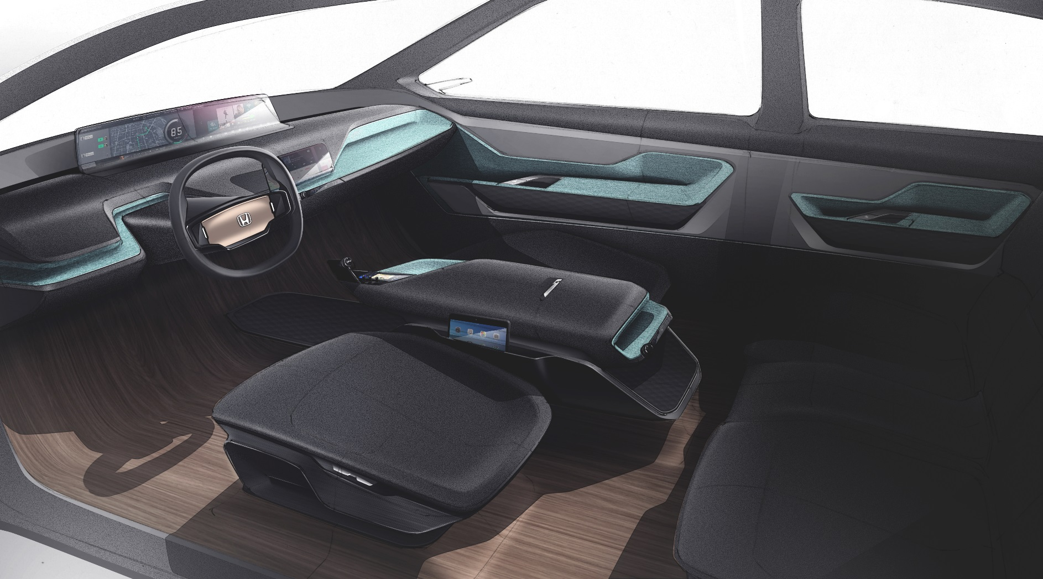

Slide 8
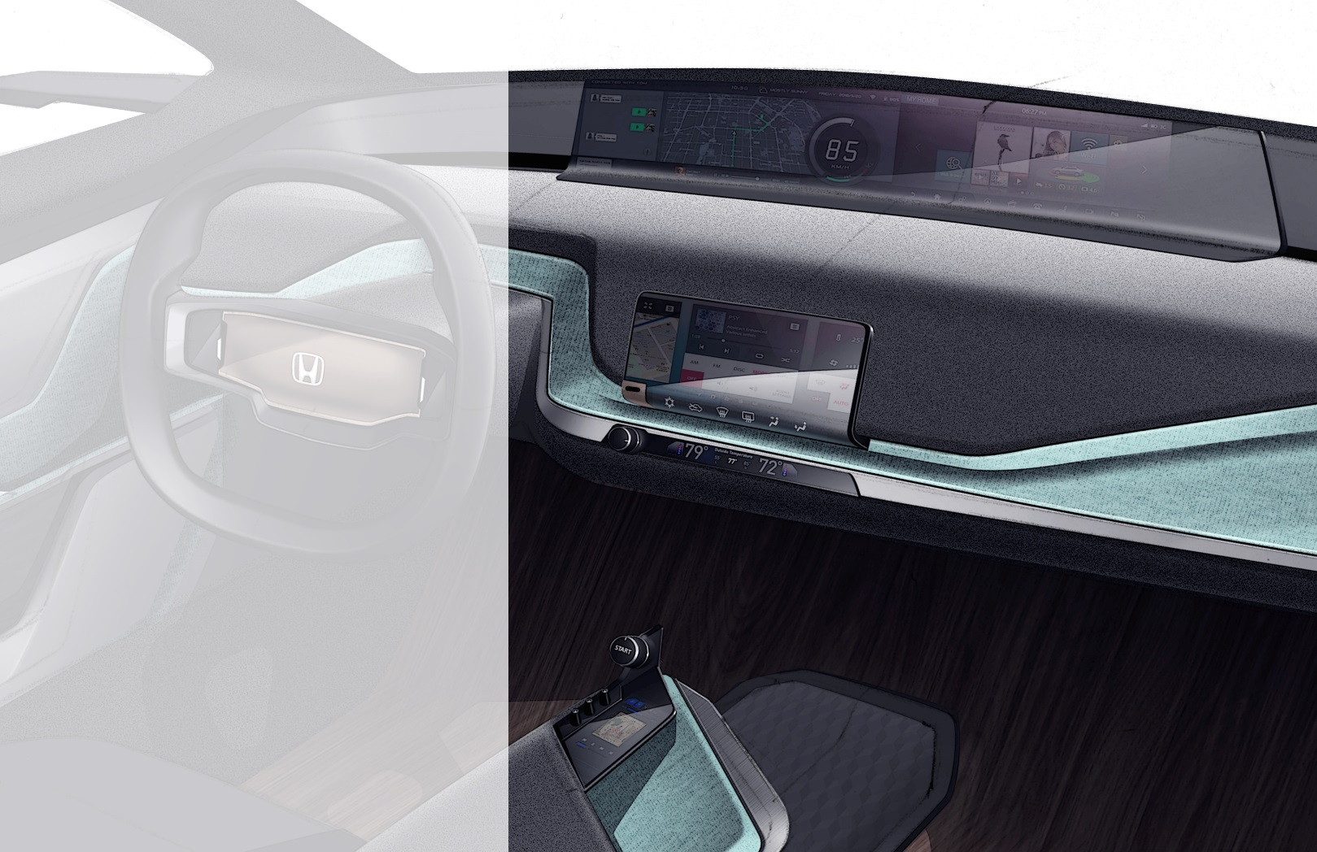
MAIN DISPLAY FOR ENTERTAINMENT AND NAVI
DIRECT TOUCH DISPLAY FOR QUICK AND INTUITIVE INTERACTION
TACTILE BUTTON FOR HVAC
START/STOP BOTTON WITH IDS
ADDITIONAL SCREEN WITH CONTENT OF OWN PREFERENCE (QUICK ACCESS MUSIC ETC)

Slide 9
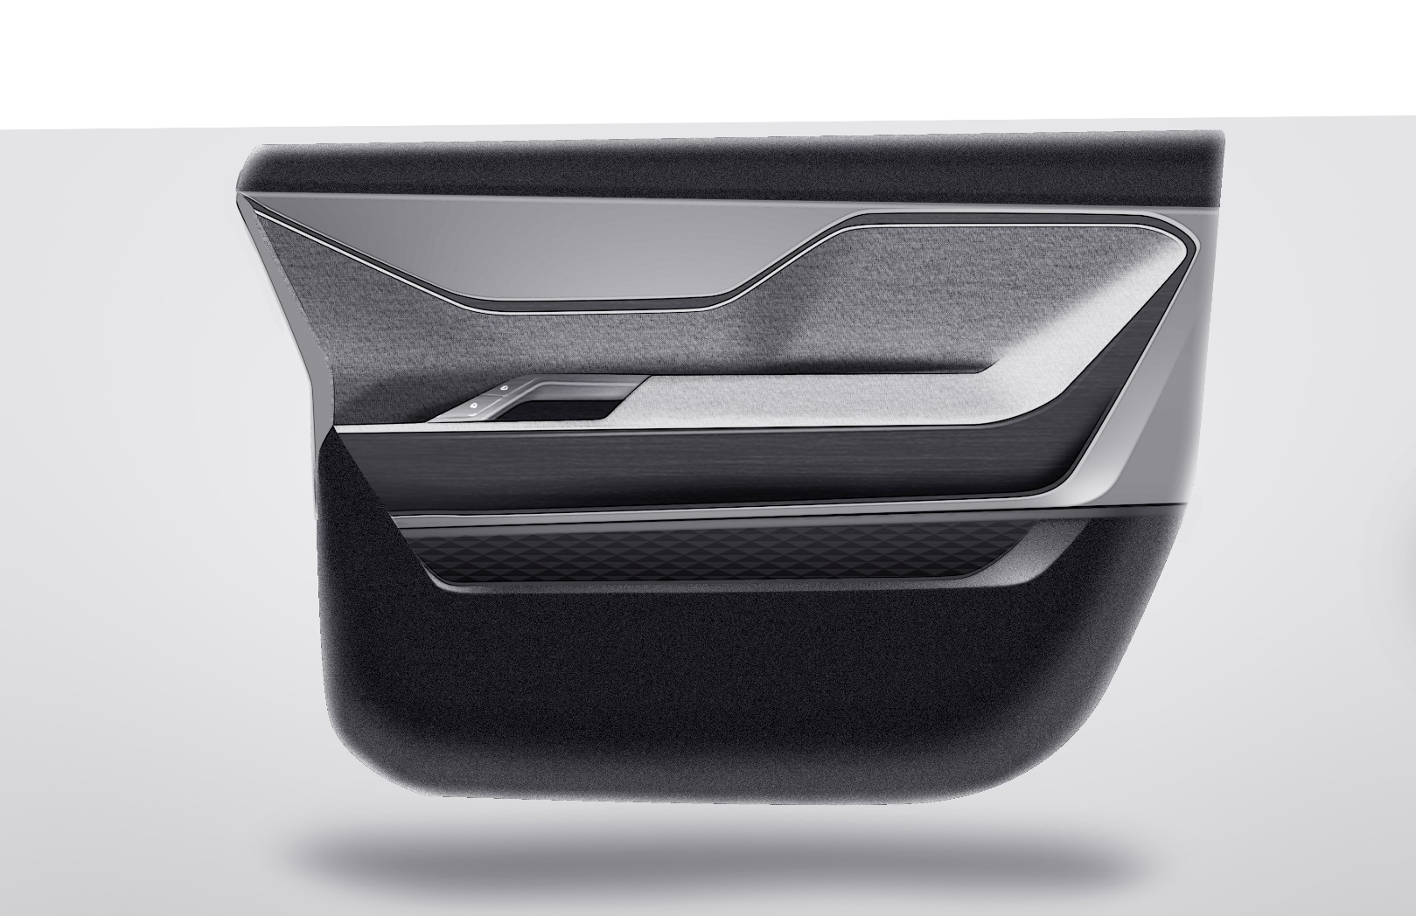

DRAMATIC GESTURE WITH ONE SURFACE PLANE

Slide 10
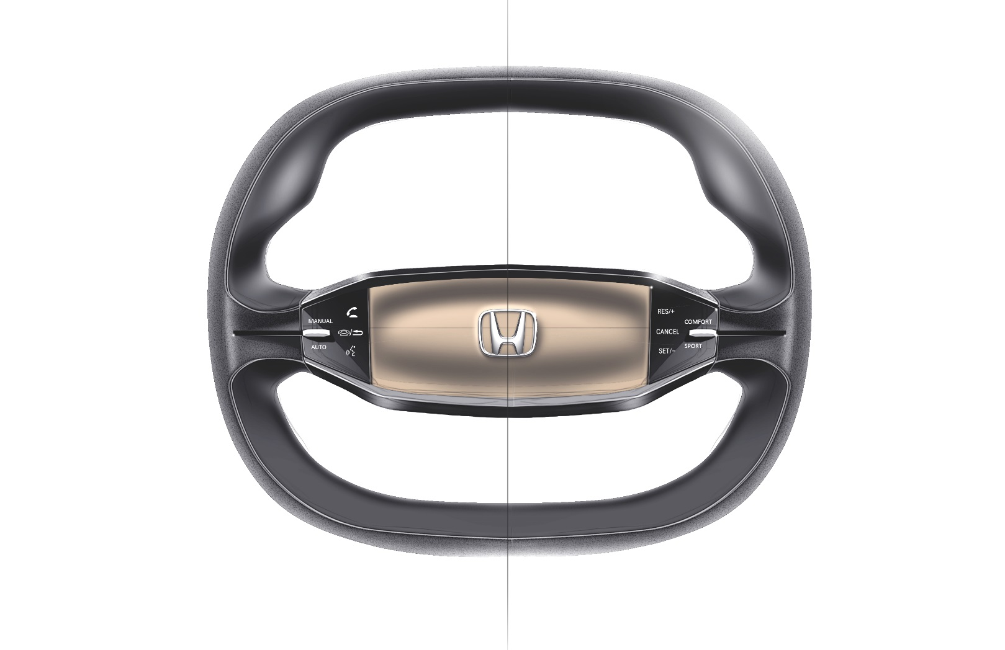
TOUCH DISPLAY
TACTILE SLIDES FOR DRIVE MODE

